Slide 1
Lab3 : a LSTM Cell for Image Captioning
Department of Computer Science, NCTU
TA Ziv(鍾嘉峻)

Slide 2
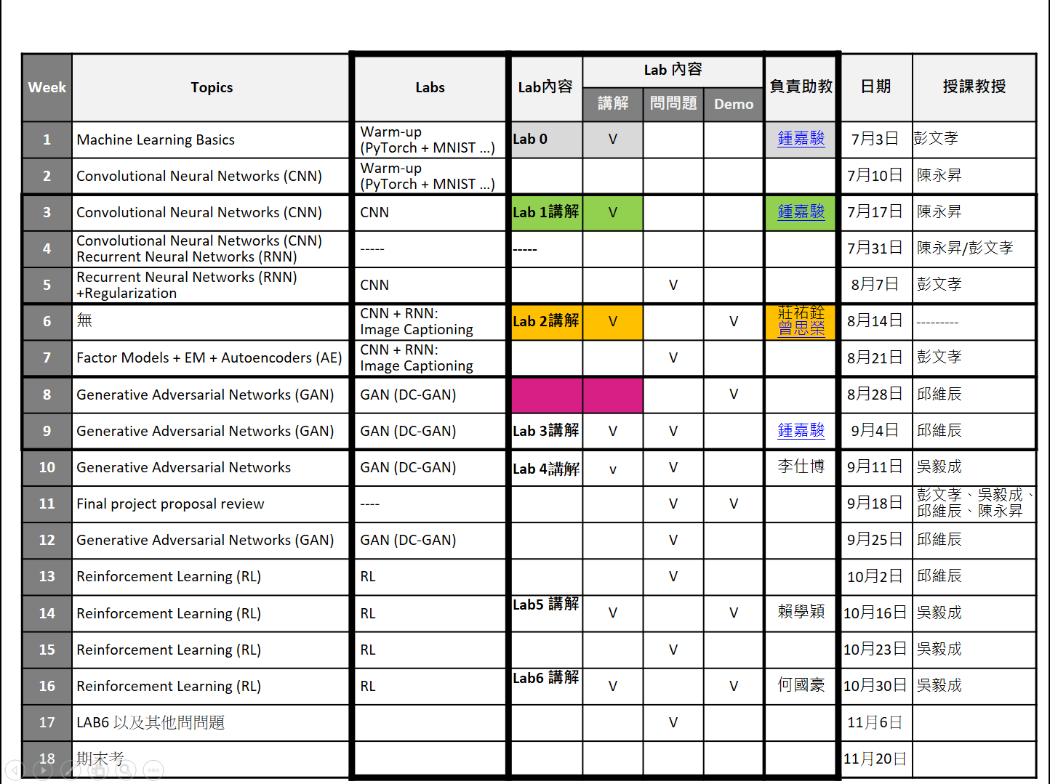

Slide 3
Important Rules
Important Date :
Report Submission Deadline: 10/16 (Wed) 11:59 AM
Demo date: 10/16 (Wed)
Turn in :
Experiment Report (.pdf)
Source code (.py)
Notice: zip all files in one file and name it like「DLP_LAB3_your studentID_name.zip」, ex: 「DLP_LAB3_0756172_鍾嘉峻.zip」

Slide 4
Important Rules
Email To :
zivzhong.cs07g@nctu.edu.tw
Don’t CC other TA
Email Tilte :
DLP_LAB3_your studentID_name
Do not submmit your weight or dataset!!
But you should save the model weight for demo

Slide 5
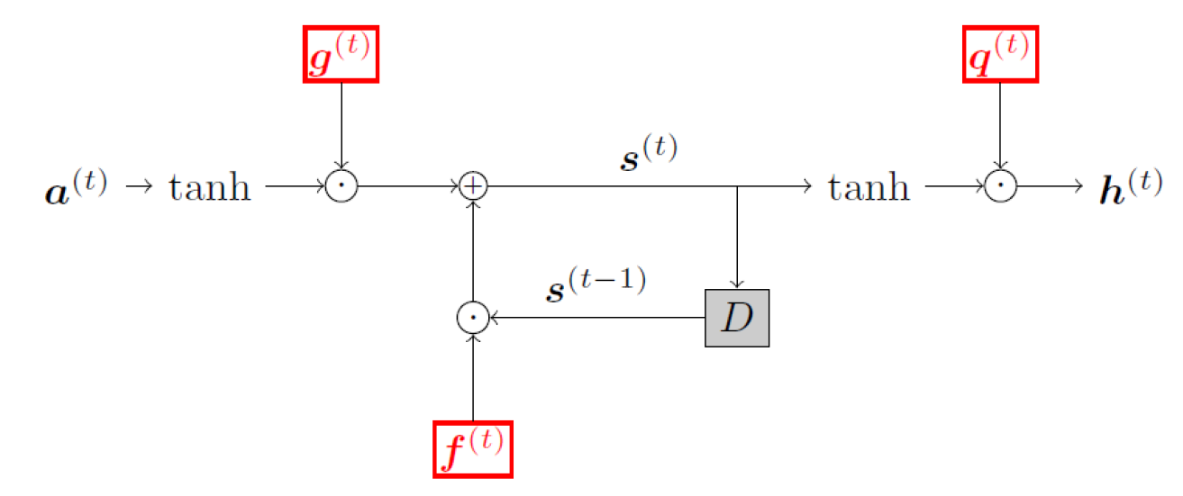
Lab Objective
In this lab, you have to implement a LSTM cell by yourselves
And train an image caption model with your own LSTM cell

Slide 6
Lab Requierment
Implement a LSTM cell
Please finish
Only Forward part , don’t worried
Replace the LSTM cell in Pytorch image-caption example with the one you implement.
Train an image caption model

Slide 7
Lab Resource & Instruction
Clone https://github.com/2019-dl-training-program/Lab3.git
Already on the sever
Please follow the Usage in Readme if you want to try on you own machine
Get the data
Already on the sever
Implement a LSTM cell (DIY_LSTM.py)
Train the model
You only need to start at “3. Preprocessing” in the Readme

Slide 8
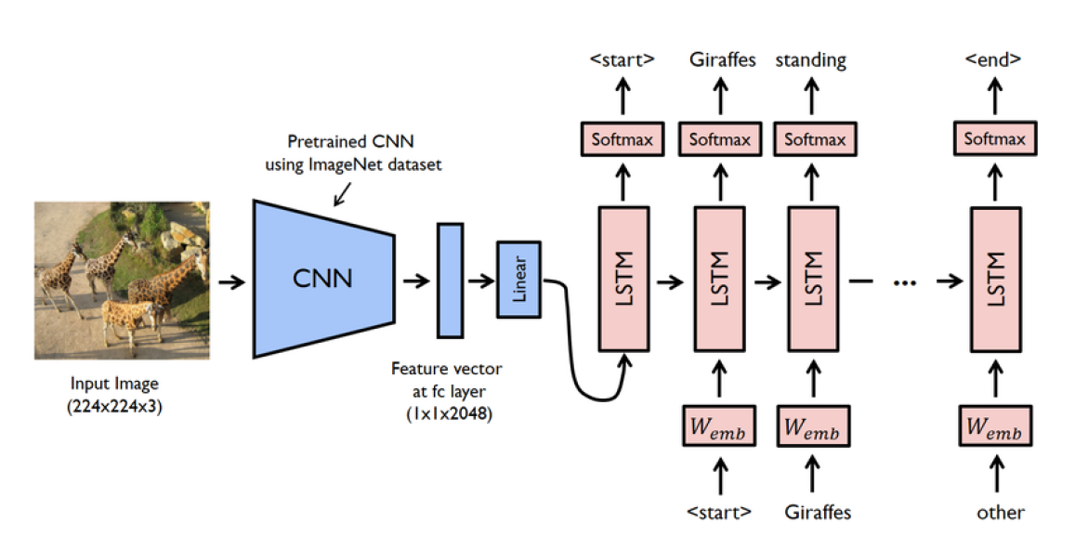
Image-Caption

Slide 9
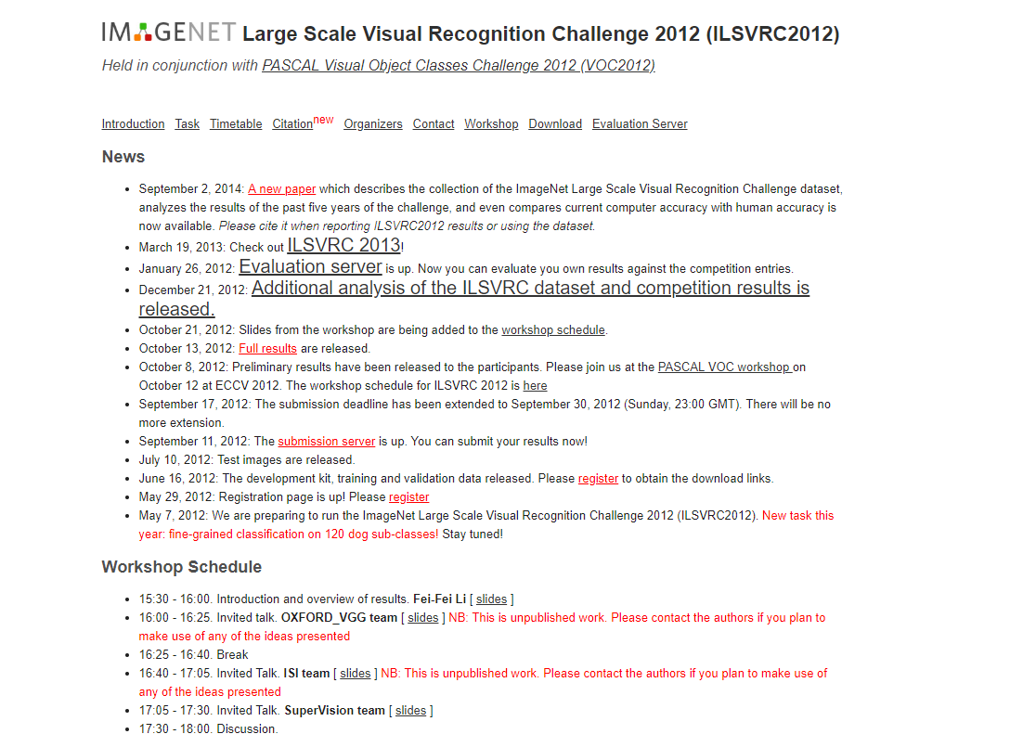
Dataset
ImageNet : Large Scale Visual Recognition Challenge 2012 (ILSVRC2012)
Very good dataset for
Classfication
localization
…..
Dataset for this lab
Image
Annotation

Slide 10
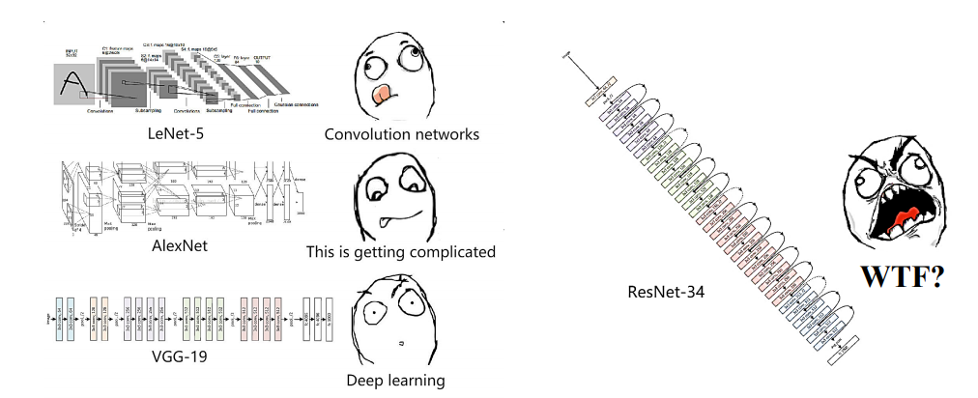

Encoder
Using pretrain models to extract feature vector from a given input image
Using pretrained ResNet-152
From Torchvision
ResNet-152

Slide 11
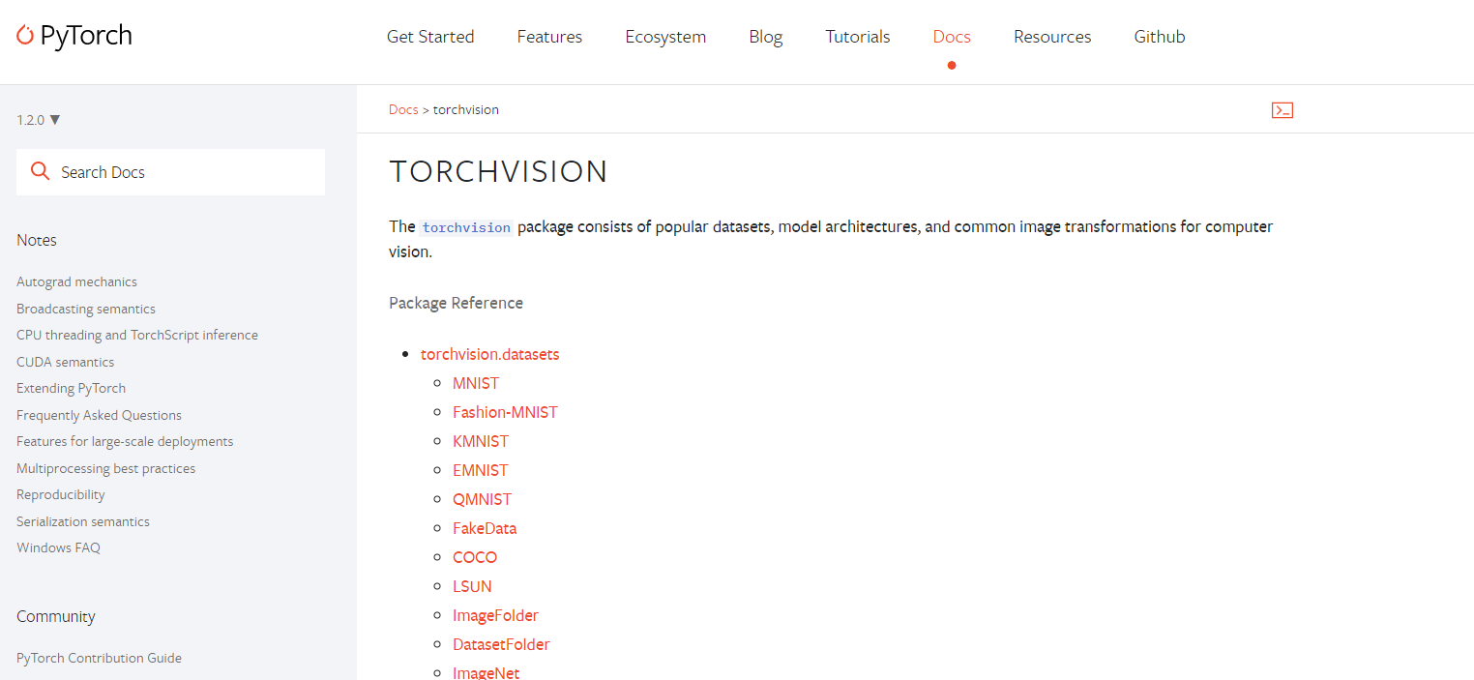
Torchvision
Pytorch official package consists of
popular datasets
model architectures
common image transformations for computer vision.

Slide 12
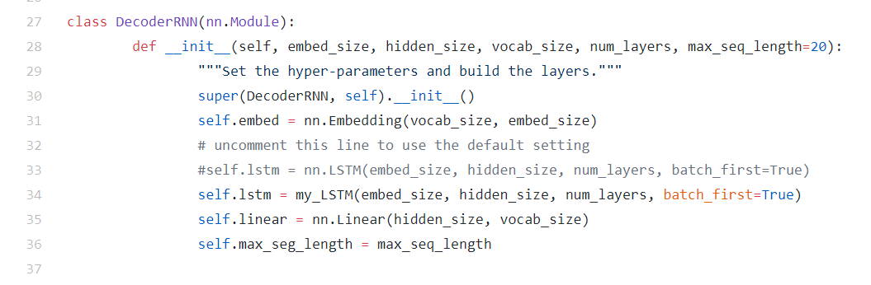
Decoder
Noticed that you will use your model in model.py line 34
You can use nn.LSTM to check your environment is OK or not

Slide 13
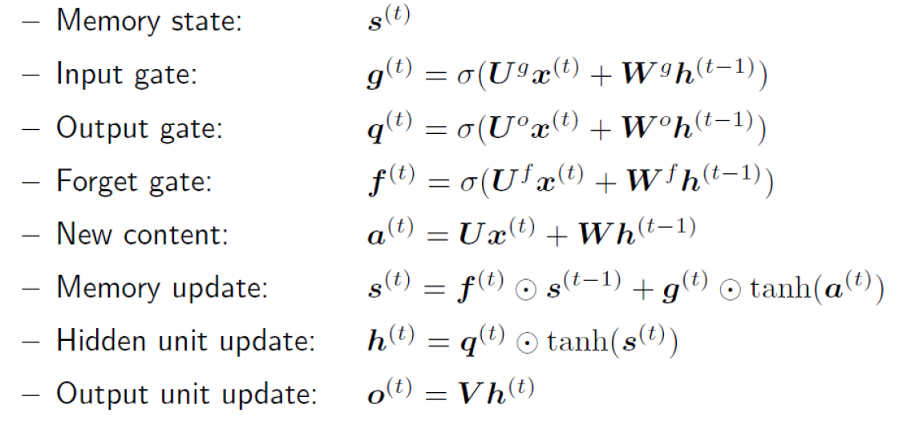
LSTM Recall
At professor slide “RecurrentNeuralNetworks.pdf”

Slide 14
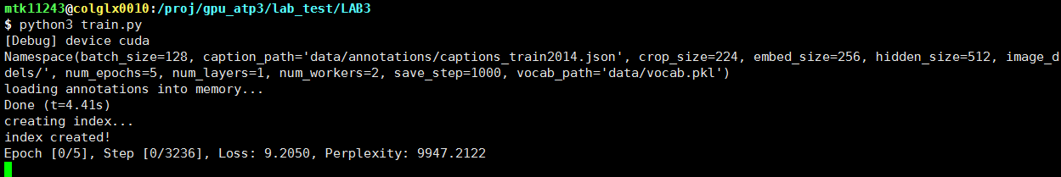
Training

Slide 15
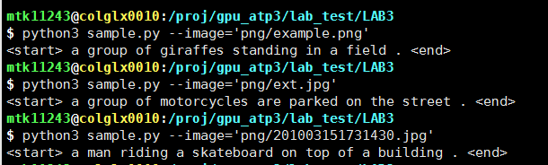
Testing

Slide 16
Report Spec & Demo
Introduction (5%)
Explain how you implement LSTM (45%)
Results – generating corresponding descriptions
A. example.png (10%)
B. ext.png (10%)
Discussion (10%)
Demo
Test your model on a given picture (10%)
Question (10%)

Slide 17
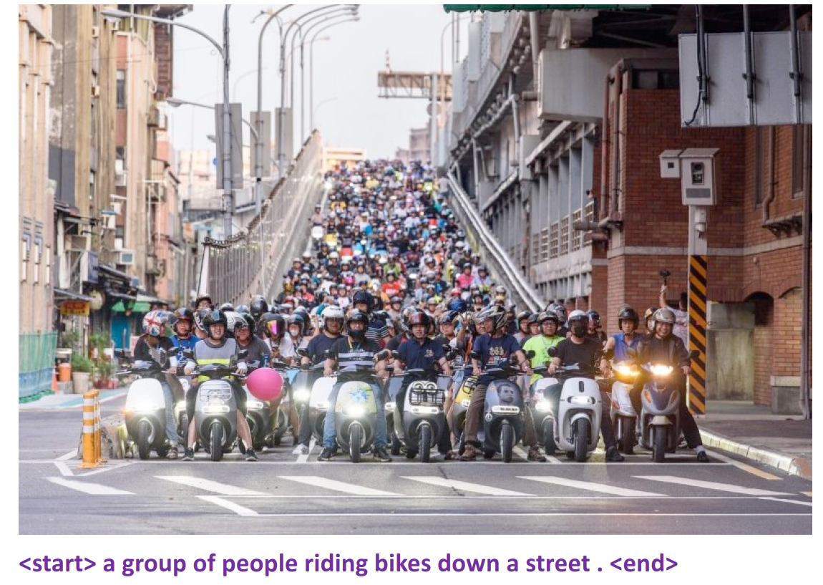
Demo example
Like “Results” in Report
The demo testing will
be uploaded before Demo

